Slide 1
PHP : Hypertext Preprocessor
MUHAMMAD ‘IZZAT BIN MOHAMAD
IT Executive (DotDot Holdings Sdn Bhd)
Alumni UniKL MIIT

Slide 2





What we will learn
What is PHP
What is a PHP File
What Can PHP Do
Why PHP
PHP Framework
Set Up WAMP
Basic PHP Syntax

Slide 3
What we will learn
Comments in PHP
PHP Variables
PHP Echo and Print
PHP Data Types
PHP Operators
PHP Conditional Statements
PHP Loops

Slide 4

What is PHP ?
PHP stands for PHP: Hypertext Preprocessor
Created by Rasmus Lerdorf
PHP is a widely-used, open-source scripting language
PHP scripts are executed on the server
PHP is free to download and use

Slide 5
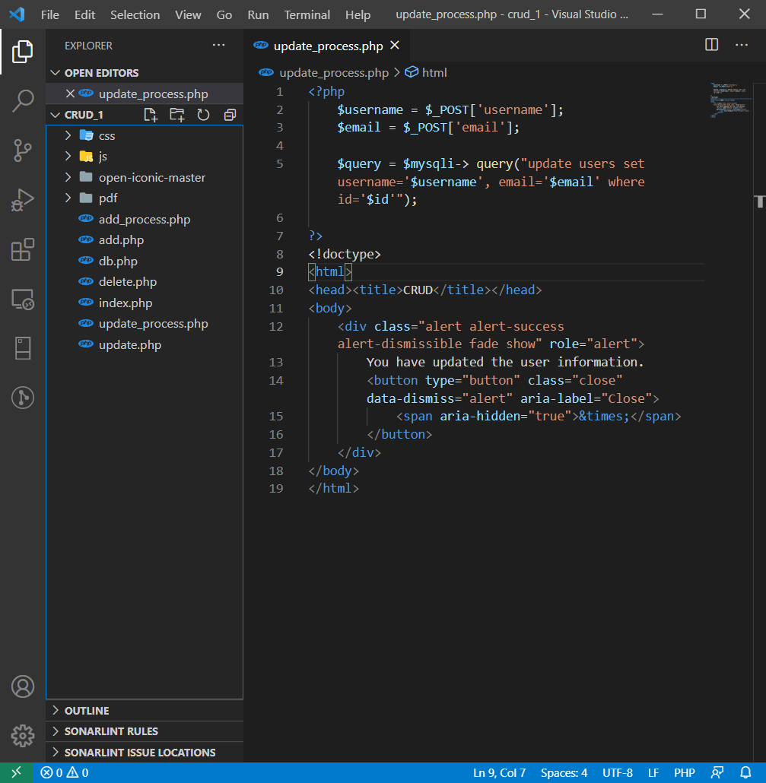
What is a PHP File ?
PHP files can contain text, HTML, JavaScript code, and PHP code
PHP code are executed on the server, and the result is returned to the browser as plain HTML
PHP files have a default file extension of ".php"

Slide 6
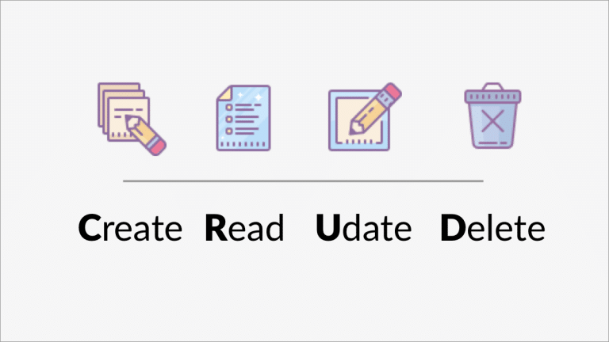
What Can PHP Do?
PHP can generate dynamic page content
PHP can create, open, read, write, and close files on the server
PHP can collect form of data
PHP can send and receive cookies/session
PHP can add, delete, modify data in your database
PHP can restrict users to access some pages on your website
PHP can encrypt data

Slide 7


Why PHP?
PHP runs on different platforms (Windows, Linux, Unix, Mac OS X, etc.)
PHP is compatible with almost all servers used today (Apache, IIS, etc.)
PHP has support for a wide range of databases
PHP is free
PHP is easy to learn
PHP runs efficiently on the server side

Slide 8
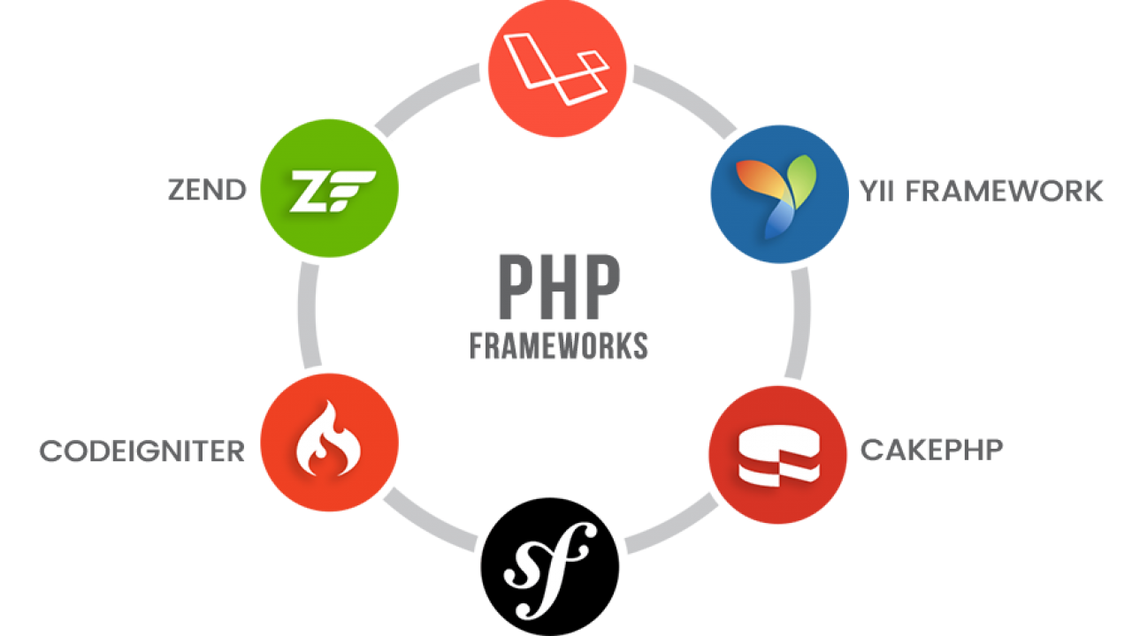
PHP Framework
A PHP framework is a platform for creating PHP web applications.
It contains libraries with pre-packaged functions and classes and often elements for software design pattern realization.
Many of the framework is based on MVC (Model, View, Controller)
Laravel, Symphony, CodeIgnitor are some of the example.
We will used Plain PHP only for this tutorial

Slide 9

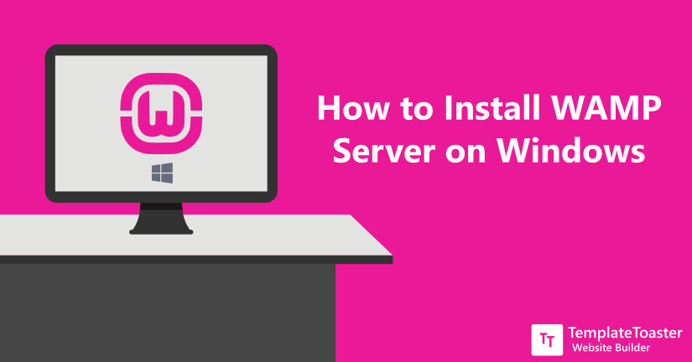
Set Up WAMP
Many local hosting available for use such as WAMP and XAMPP
It already have a lot of setup inside such as PHP, PhpMyAdmin, Apache and MySQL
We will used WAMP for this tutorial
Download WAMP from the official WAMP website: https://www.wampserver.com/en/download-wampserver-64bits/
Follow the step by step provided: https://blog.templatetoaster.com/how-to-install-wamp/

Slide 10

Basic PHP Syntax
A PHP script can be placed anywhere in the document.
A PHP script starts with <?php and ends with ?> :
The default file extension for PHP files is ".php".

Slide 11
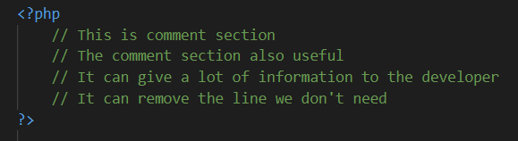
Comments in PHP
Example :

Slide 12
PHP Variables
Variable can have short names (like $x and $y) or more descriptive names ($age, $name, $total)
Rules for PHP variables:
A variable starts with the $ sign, followed by the name of the variable
A variable name must begin with a letter or the underscore character
A variable name can only contain alpha-numeric characters and underscores (A-z, 0-9, and _ )
A variable name should not contain spaces
Variable names are case sensitive ($y and $Y are two different variables)

Slide 13
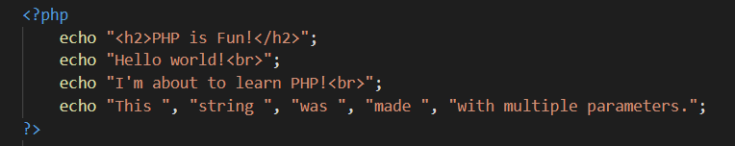
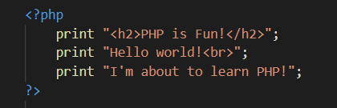
PHP Echo and Print
Echo and print are more or less the same. They are both used to output data to the screen.
The differences are small:
echo can take multiple parameters (although such usage is rare) while print can take one argument
echo is marginally faster than print

Slide 14
PHP Data Types
Variables can store data of different types, and different data types can do different things.
PHP supports the following data types:
String (“name”)
Integer (12)
Float/Double (4.56)
Boolean (true or false)
Array (array(“Volvo”, “BMW”, “Toyota”))
NULL (null)
Object
Resource

Slide 15
PHP Operators
Operators are used to perform operations on variables and values.
PHP divides the operators in the following groups:
Arithmetic operators
Assignment operators
Comparison operators
Increment/Decrement operators
Logical operators
String operators
Array operators
Conditional assignment operators

Slide 16
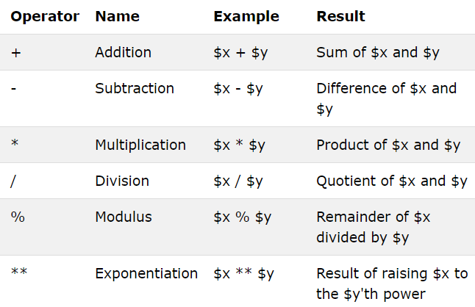
Arithmetic operators
The PHP arithmetic operators are used with numeric values to perform common arithmetical operations, such as addition, subtraction, multiplication etc.

Slide 17
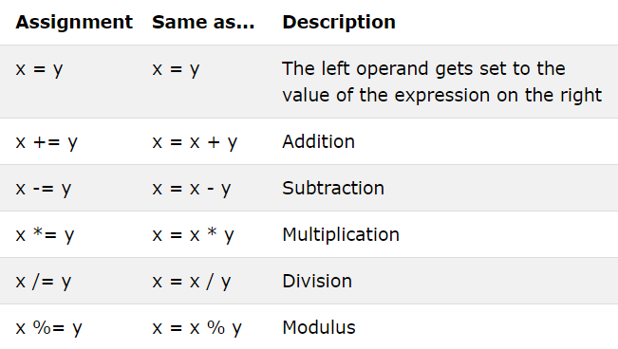
Assignment operators
The PHP assignment operators are used with numeric values to write a value to a variable.
The basic assignment operator in PHP is "=". It means that the left operand gets set to the value of the assignment expression on the right.

Slide 18
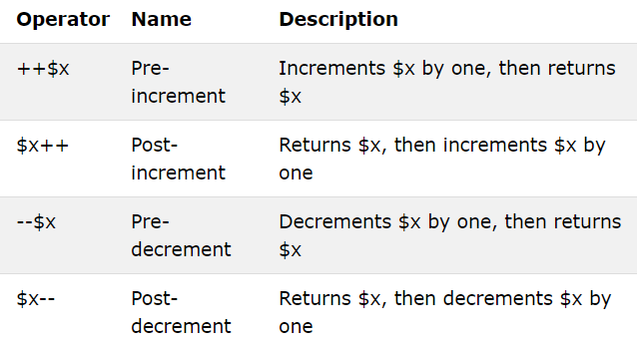
Increment/Decrement operators
The PHP increment operators are used to increment a variable's value.
The PHP decrement operators are used to decrement a variable's value.

Slide 19
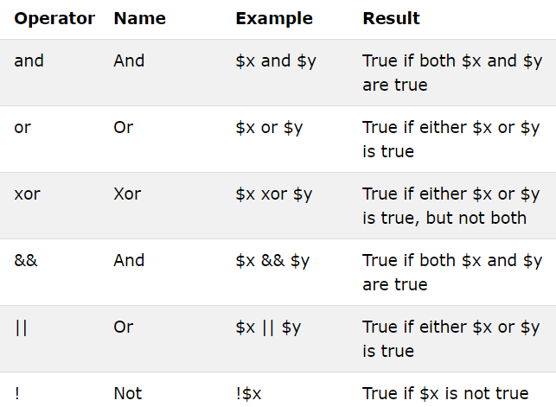
Logical operators
The PHP logical operators are used to combine conditional statements.

Slide 20
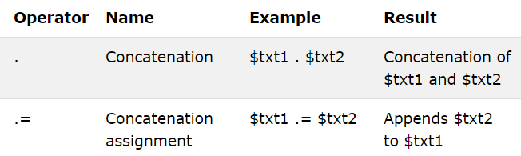
String operators
PHP has two operators that are specially designed for strings.

Slide 21
PHP Conditional Statements
In PHP we have the following conditional statements
if statement - executes some code if one condition is true
if...else statement - executes some code if a condition is true and another code if that condition is false
if...elseif...else statement - executes different codes for more than two conditions
switch statement - selects one of many blocks of code to be executed

Slide 22
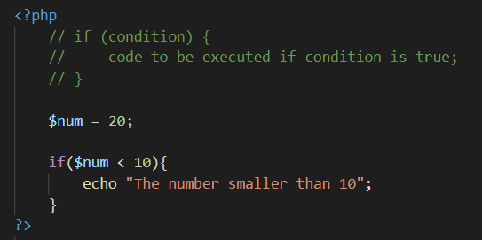
if statement
The if statement executes some code if one condition is true.

Slide 23
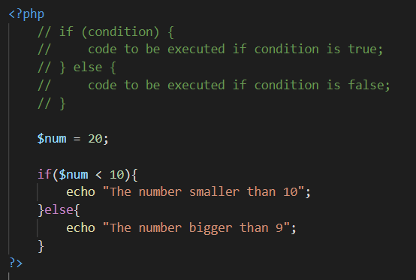
if...else statement
executes some code if a condition is true and another code if that condition is false

Slide 24
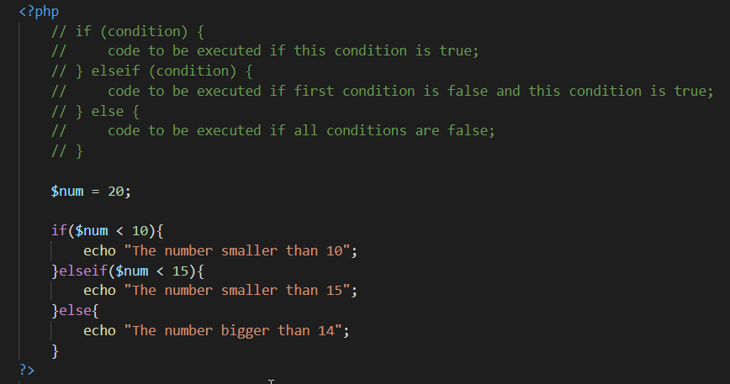
if...elseif...else statement
executes different codes for more than two conditions

Slide 25
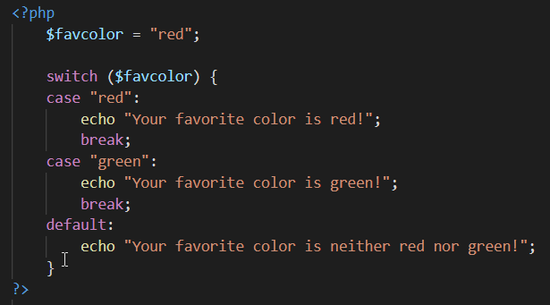
switch statement
selects one of many blocks of code to be executed
Use break to prevent the code from running into the next case automatically
The default statement is used if no match is found

Slide 26
PHP Loops
Loops are used to execute the same block of code again and again, if a certain condition is true.
In PHP, we have the following loop types:
while - loops through a block of code if the specified condition is true
do...while - loops through a block of code once, and then repeats the loop if the specified condition is true
for - loops through a block of code a specified number of times
foreach - loops through a block of code for each element in an array

Slide 27
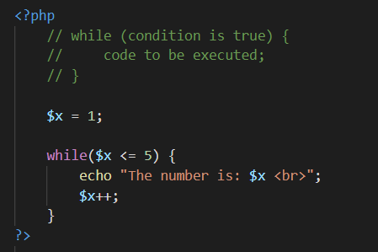
while loop
loop executes a block of code if the specified condition is true.

Slide 28
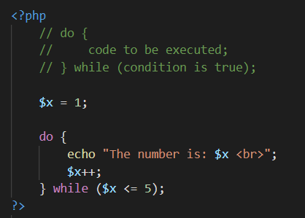
do...while loop
Loops through a block of code once, and then repeats the loop if the specified condition is true.

Slide 29
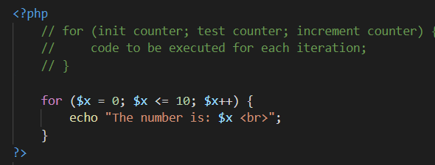
for loop
Loops through a block of code a specified number of times.
init counter: initialize the loop counter value
test counter: evaluated for each loop iteration. If it evaluates to TRUE, the loop continues. If it evaluates to FALSE, the loop ends.
increment counter: increases the loop counter value

Slide 30
Thank you for your time here ☺

